Slide 1
Phylogenetics Peer Review
Michael Hart

Slide 2
Gene/gene family and its relationship to C. auris Adhesive Properties
Research Question: Why does C. auris display such strong adhesive properties compared to closely related fungi?
The gene I chose (protein CJI97_000055) contains a large segment belonging to the GPI (glycophosphatidylinositol)-anchored superfamily, which has been implicated as a unique contributor to C. auris stickiness (Munoz et al 2018).
Phylogenetic analysis may provide hints as to when and in what species either CJI97_000055 or the GPI-anchored superfamily expanded compared to closely related Candida species.
Notes:
Describe your gene/gene family and the basis/justification for its relationship to the theme.

Slide 3
Table 1
Notes:
Present your Table 1 -- if you haven’t finished collecting all the sequences, put “TBD” in the cell. For species that you have searched and didn’t identify any homolog, put “NA”.

Slide 4
Identifying Homologous Sequences
Difficulties:
My gene is not well-researched, so had to BLAST to find sequences.
Lots of “uncharacterized protein”, etc.
Couldn’t easily find Candida krusei or Candida parapsilosis
Couldn’t figure out the “align 2 sequences feature” for sequence similarity
Unsure if we are supposed to just put the root where it is in the Munoz paper or not.
Tips:
Used BLASTN to find proteins for the given species, then went to the gene page for the nucleotide name, length, type, and FASTA.
Notes:
Discuss how you identified the homologous sequences, difficulties you have encountered or tips you collected for doing things more efficiently, e.g. different databases, BLAST vs HMMER etc.

Slide 5
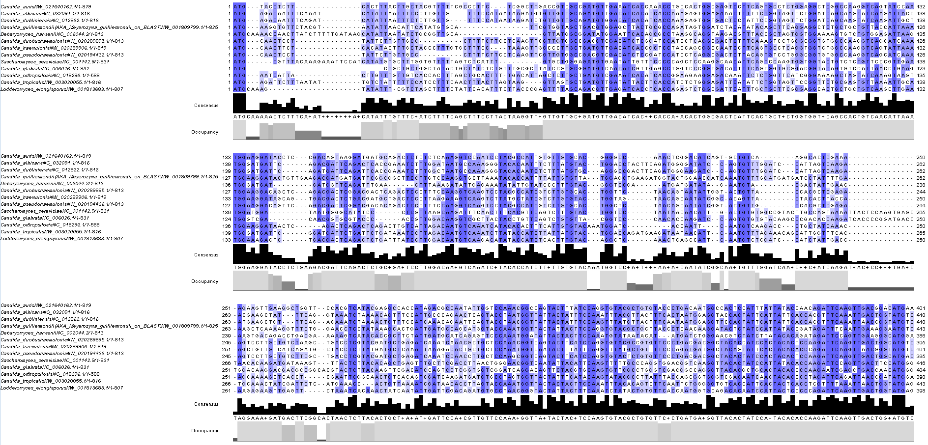
Multi-sequence Alignment
Notes:
Show screenshot(s) of your multi-sequence alignment. Discuss whether you think the alignment is reasonable and will provide a solid basis for phylogenetic analysis. If the alignment is poor, discuss possible reasons and how you will proceed forward.

Slide 6
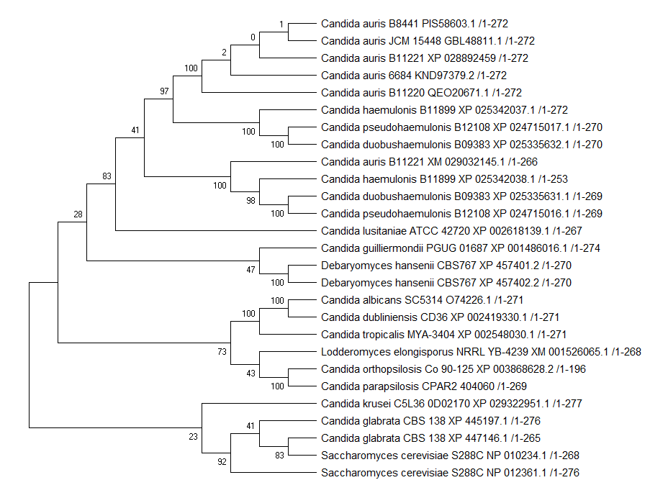
Maximum Parsimony Tree
Maximum Parsimony analysis of taxa
The evolutionary history was inferred using the Maximum Parsimony method. Tree #1 out of 5 most parsimonious trees (length = 1540) is shown. The consistency index is ( 0.636856), the retention index is ( 0.693188), and the composite index is 0.451923 ( 0.441461) for all sites and parsimony-informative sites (in parentheses). The percentage of replicate trees in which the associated taxa clustered together in the bootstrap test (100 replicates) are shown next to the branches [1]. The MP tree was obtained using the Subtree-Pruning-Regrafting (SPR) algorithm (pg. 126 in ref. [2]) with search level 1 in which the initial trees were obtained by the random addition of sequences (10 replicates). This analysis involved 27 amino acid sequences. There were a total of 323 positions in the final dataset. Evolutionary analyses were conducted in MEGA X [3]. 1. Felsenstein J. (1985). Confidence limits on phylogenies: An approach using the bootstrap. Evolution 39:783-791.
2. Nei M. and Kumar S. (2000). Molecular Evolution and Phylogenetics. Oxford University Press, New York.
3. Kumar S., Stecher G., Li M., Knyaz C., and Tamura K. (2018). MEGA X: Molecular Evolutionary Genetics Analysis across computing platforms. Molecular Biology and Evolution 35:1547-1549.
Disclaimer: Although utmost care has been taken to ensure the correctness of the caption, the caption text is provided "as is" without any warranty of any kind. Authors advise the user to carefully check the caption prior to its use for any purpose and report any errors or problems to the authors immediately (www.megasoftware.net). In no event shall the authors and their employers be liable for any damages, including but not limited to special, consequential, or other damages. Authors specifically disclaim all other warranties expressed or implied, including but not limited to the determination of suitability of this caption text for a specific purpose, use, or application.
FIGURE 1: Maximum Parsimony Tree
Notes:
Show a preliminary tree reconstructed from the alignment. Present the methodology for tree reconstruction (method, parameters used), how you root the tree, and what are you interpretation of the tree topology.

Slide 7
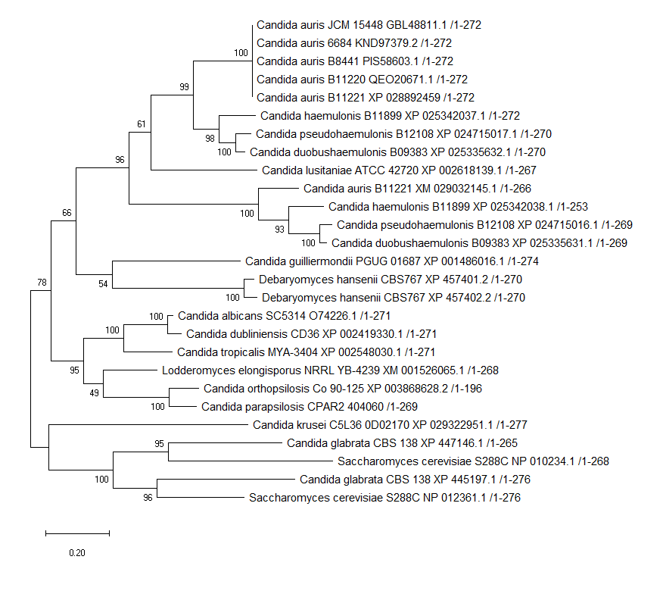
Maximum Likelihood Tree
Evolutionary analysis by Maximum Likelihood method The evolutionary history was inferred by using the Maximum Likelihood method and JTT matrix-based model [1]. The tree with the highest log likelihood (-8507.65) is shown. The percentage of trees in which the associated taxa clustered together is shown next to the branches. Initial tree(s) for the heuristic search were obtained automatically by applying Neighbor-Join and BioNJ algorithms to a matrix of pairwise distances estimated using a JTT model, and then selecting the topology with superior log likelihood value. The tree is drawn to scale, with branch lengths measured in the number of substitutions per site. This analysis involved 27 amino acid sequences. There were a total of 323 positions in the final dataset. Evolutionary analyses were conducted in MEGA X [2].
1. Jones D.T., Taylor W.R., and Thornton J.M. (1992). The rapid generation of mutation data matrices from protein sequences. Computer Applications in the Biosciences 8: 275-282.
2. Kumar S., Stecher G., Li M., Knyaz C., and Tamura K. (2018). MEGA X: Molecular Evolutionary Genetics Analysis across computing platforms. Molecular Biology and Evolution 35:1547-1549.
Disclaimer: Although utmost care has been taken to ensure the correctness of the caption, the caption text is provided "as is" without any warranty of any kind. Authors advise the user to carefully check the caption prior to its use for any purpose and report any errors or problems to the authors immediately (www.megasoftware.net). In no event shall the authors and their employers be liable for any damages, including but not limited to special, consequential, or other damages. Authors specifically disclaim all other warranties expressed or implied, including but not limited to the determination of suitability of this caption text for a specific purpose, use, or application.
FIGURE 2: Maximum Likelihood Tree
Notes:
Show a preliminary tree reconstructed from the alignment. Present the methodology for tree reconstruction (method, parameters used), how you root the tree, and what are you interpretation of the tree topology.

